Slide 1


Slide 2
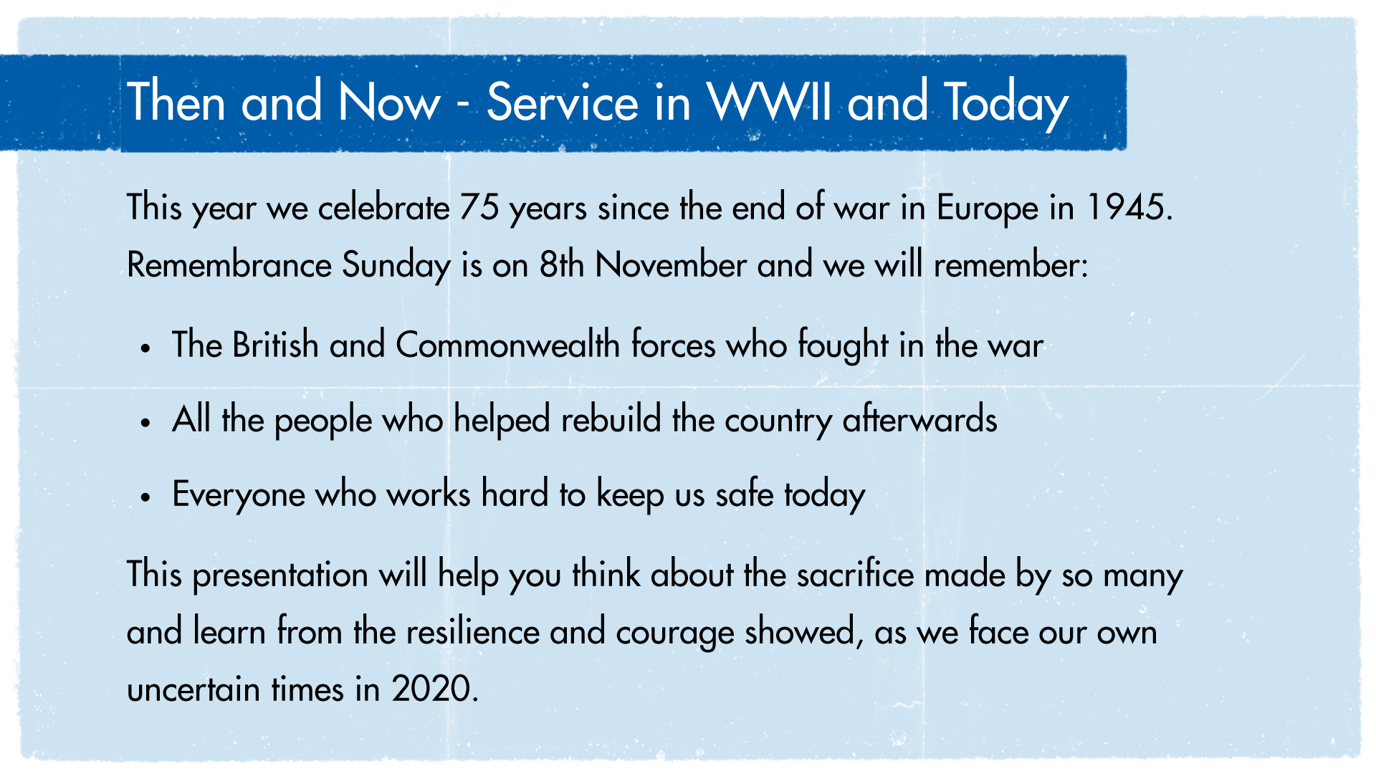

Slide 3
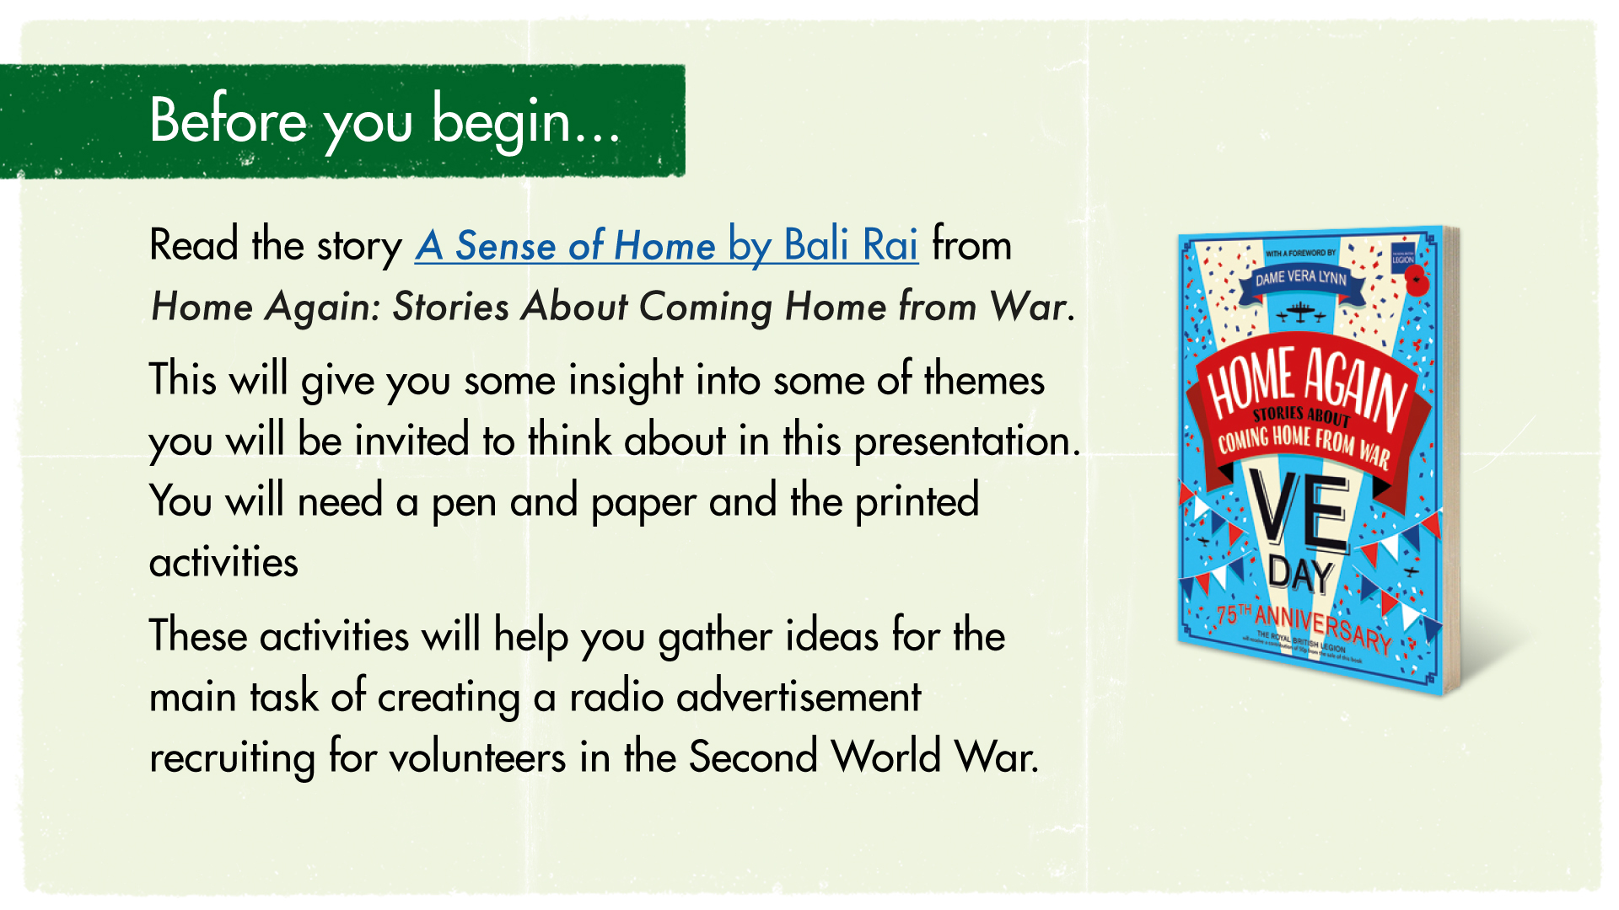
Notes:
Teacher Notes – Find A Sense of Home here: https://www.docdroid.net/yDVLPMc/a-sense-of-home-pdf

Slide 4
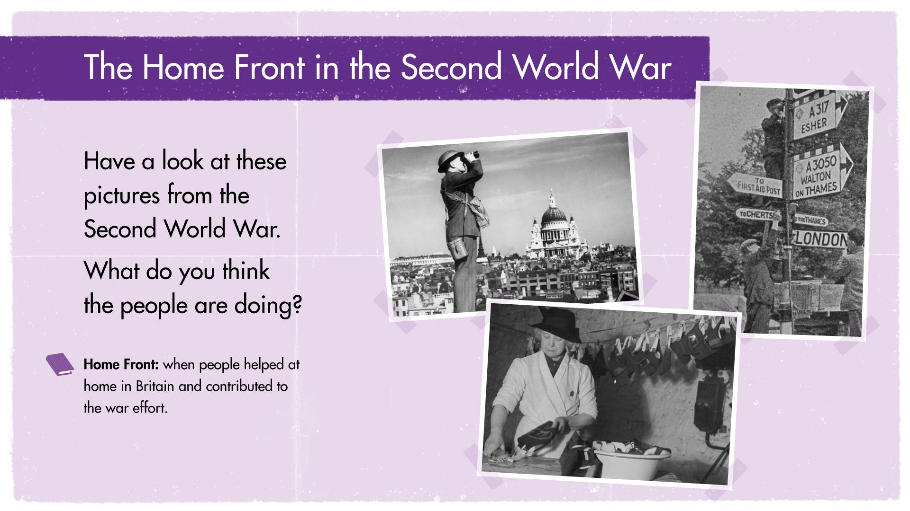
Notes:
In the story, Fred volunteers to help on the Home Front. The Home Front was when people helped at home in Britain and contributed to the war effort.
What does it mean to ‘volunteer’? Look this up in a dictionary. You can use an online dictionary if you don’t have one at home https://dictionary.cambridge.org/
When Second World War began in 1939, not everyone went to fight. Like Fred in the story, many were too old to fight, but had previously fought in the First World War and wanted to help. Instead, they would volunteer to help on the Home Front as part of the war effort
The government needed people to help with all sorts of things to keep everyone safe, support the armed services and make sure they had enough food

Slide 5
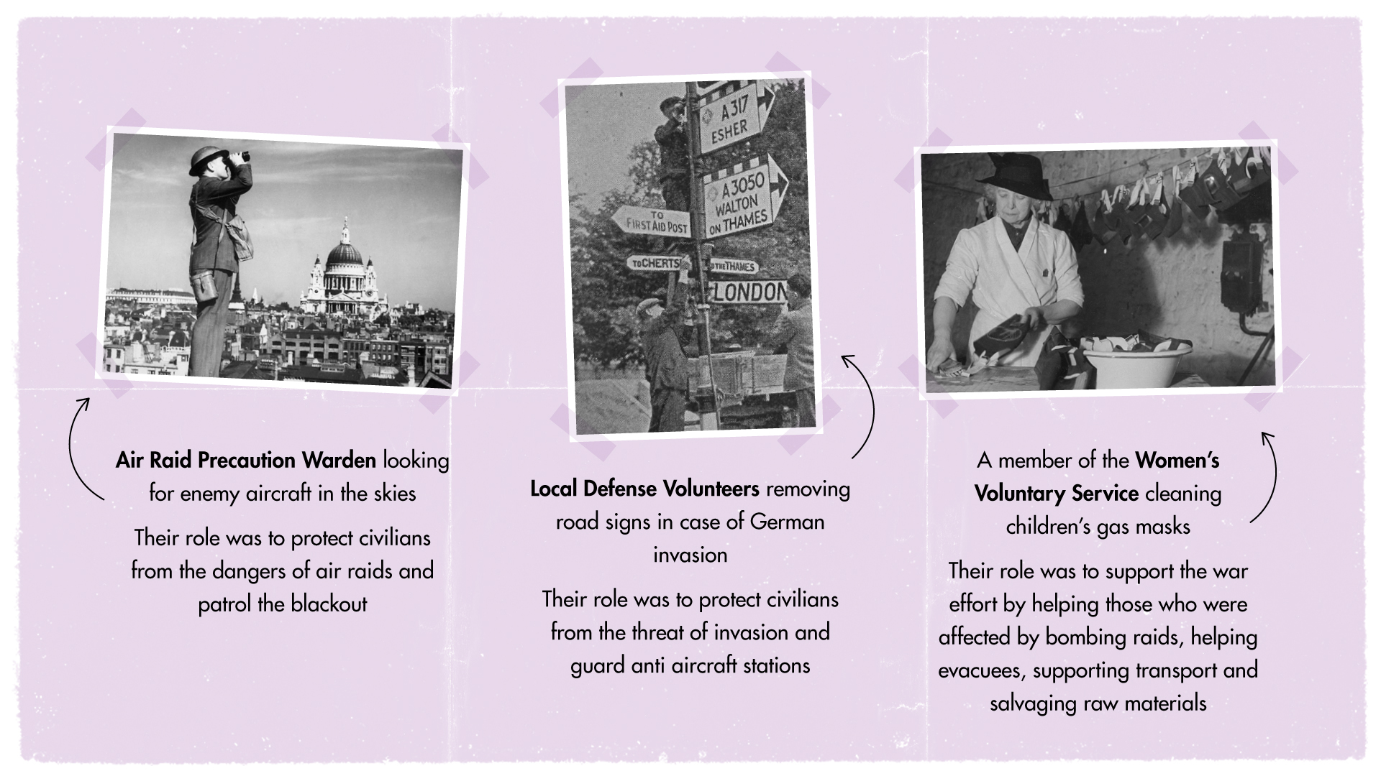
Notes:
Find the ARP Wardens and Defence Volunteers Fact files (p4) herehttps://www.docdroid.net/yDVLPMc/a-sense-of-home-pdf
For more information about Air Raid Precaution Wardens and Local Defense Volunteers read the provided factfiles from Home Again.
To volunteer is to give up your time for free to help others.
Encourage children to think about the variety of the roles and the many different things each volunteer did.
Challenge: Were there any other types of volunteer roles in the Second World War?

Slide 6
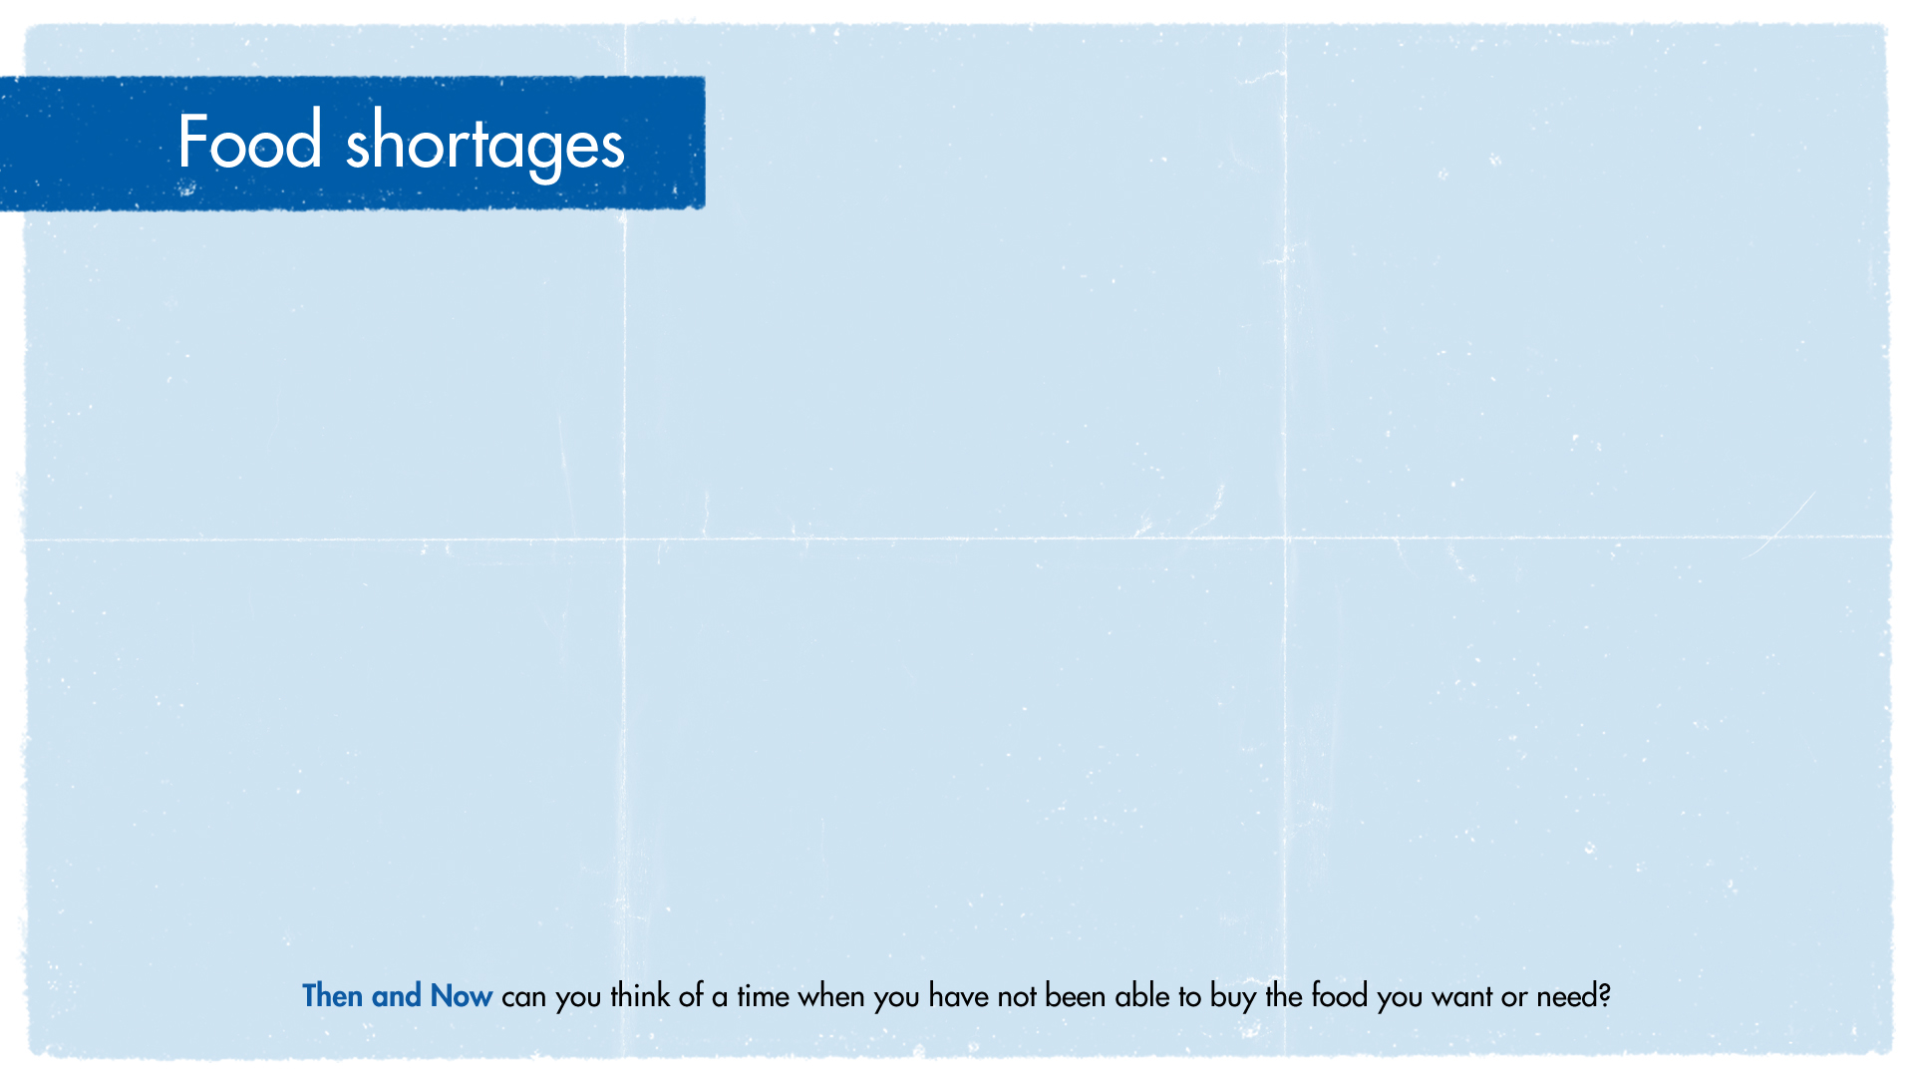
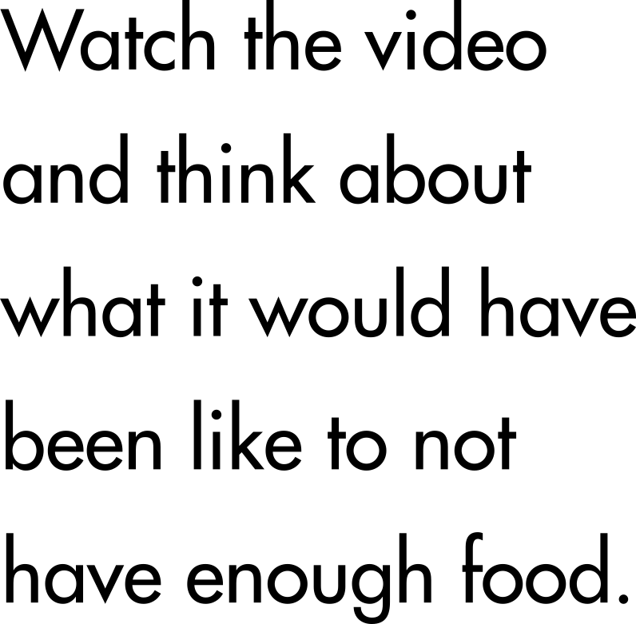

Notes:
NB: Only need up to 2.58 s not whole thing
Find the Food Rationing and So What Did Everyone Eat? (p5) Fact files here https://www.docdroid.net/yDVLPMc/a-sense-of-home-pdf
For more information about food rationing see the Factfiles Rationing and ‘So what did everyone eat?’ from Home Again
To help with food shortages, everyone was encouraged to volunteer to grow their own vegetables and fruit; gardens and tennis courts were changed into vegetable patches.
Leaflets showed people how to use their land to help Dig for Victory. People were recruited to help farm the land – this was a paid position for some. Many of these were women, as most of the men had left to fight. This was called the Land Army – watch the video to find out more.
Challenge: Why were there food shortages? Invite children to explore this and find out more about rationing.
Then and now discussion: How would people feel about growing their own fruit and vegetables? How would people have felt about food rationing and not knowing if their food would run out? Can you think of a time when you or your family have worried about not having enough or had to queue to buy food? Have you ever grown your own food?

Slide 7
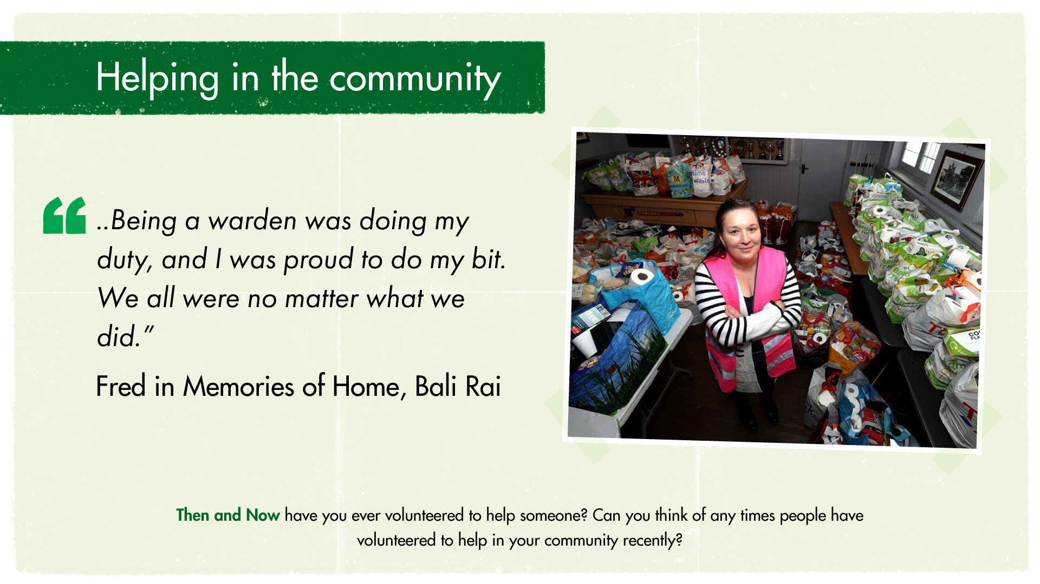
Notes:
Just like Fred in the story, volunteers often faced danger when they were volunteering, but they still did it anyway.
Then and now discussion: Ask children to think about any volunteers they know or anything they may have done to volunteer. What kinds of volunteering do they know of? Examples of recent volunteering during the pandemic include:
NHS Volunteers who helped deliver medicines
Food bank volunteers who helped put packages of food together for people in need
Meals on wheels volunteers delivering meals to elderly and vulnerable who couldn’t leave their homes due to shielding
Remind children that anyone volunteering during the lockdown have put themselves in danger and at more risk of catching Covid 19.

Slide 8
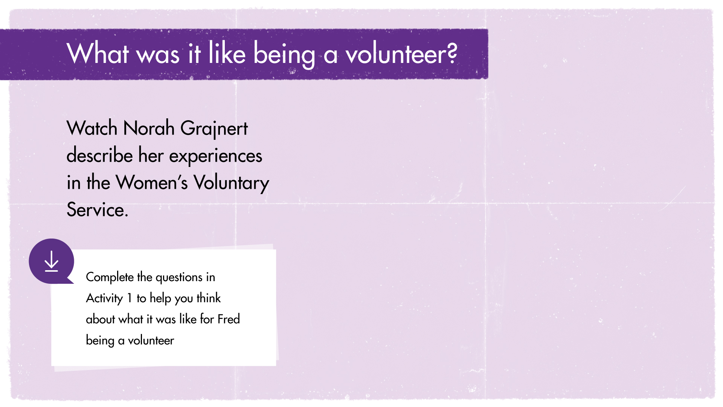
Notes:
Activity Sheet 1: https://storage.rblcdn.co.uk/sitefinity/docs/default-source/remembrancedocs/new-teaching-remembrance-resources/ks2_activity1_understandingvolunteers.pdf
Being a volunteer during in the Second World War was dangerous and difficult.
Watch the video about Norah and her experiences in the WVS. What happens to Norah whilst she is serving tea? Why is she asked to move her van?
Now answers the questions in Activity 1 and think about the difficulties and dangers volunteers faced when they were working. Why did they still want to volunteer even though it was dangerous?

Slide 9
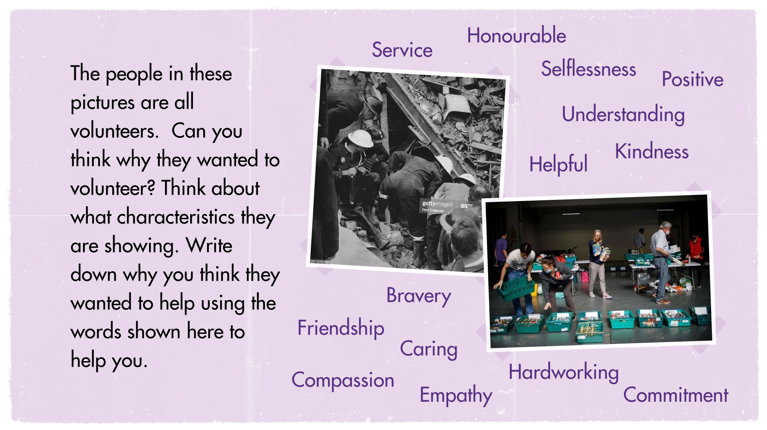
Notes:
Look at the images showing:
Air Raid Precaution Wardens in the Second World War searching for survivors
Food Bank volunteers helping prepare packages of food for people in need during the pandemic.
Why do you think people in these pictures wanted to volunteer? What characteristics are they showing? Can you think of any other types of volunteers who have been helping in during the pandemic? Do you know any volunteers?

Slide 10
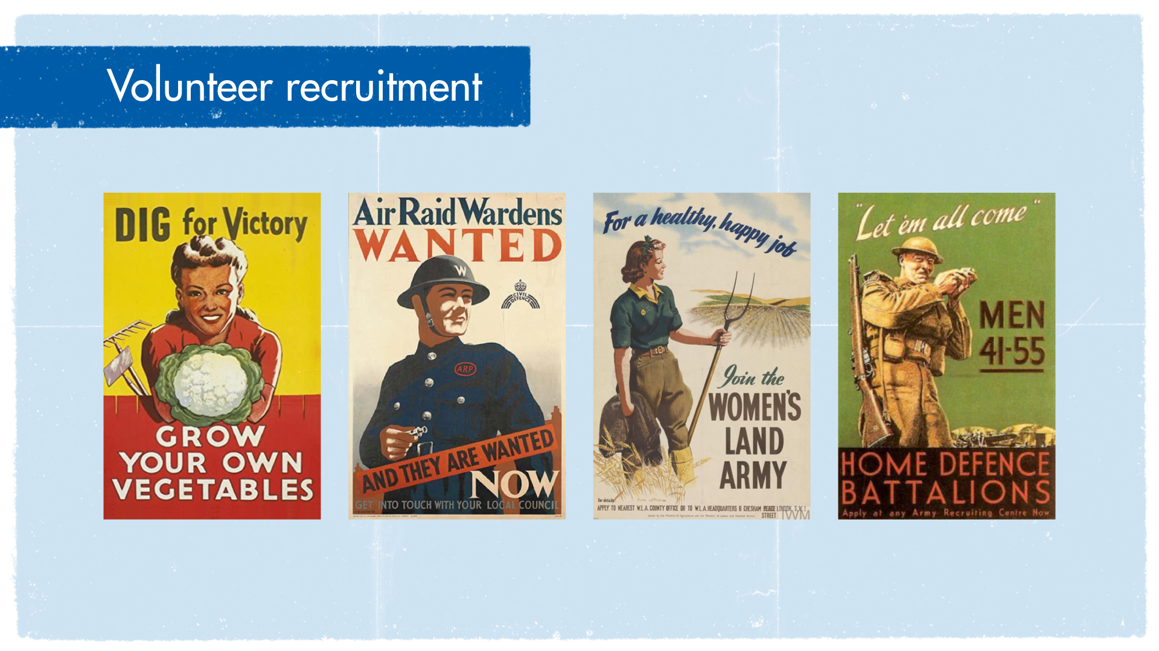
Notes:
Images of Second World War Home Front recruitment posters
Recruitment for volunteers to help with the war effort took place throughout the war. The Ministry of Information was responsible for advertising campaigns. They used the television and radio to promote information campaigns such as Dig for Victory and poster campaigns and advertisements in newspapers also helped recruit volunteers.
The advertising was a success:
By 1944 over one third of the population were involved in the war effort at home.
Some were paid workers and some were volunteers helping in their local communities.
Over 1 million people volunteered as ARPs, 1.5 million men volunteered for the Home Guard.
By 1943 over 1 million tonnes of vegetables were being grown in gardens and allotments across Britain.

Slide 11
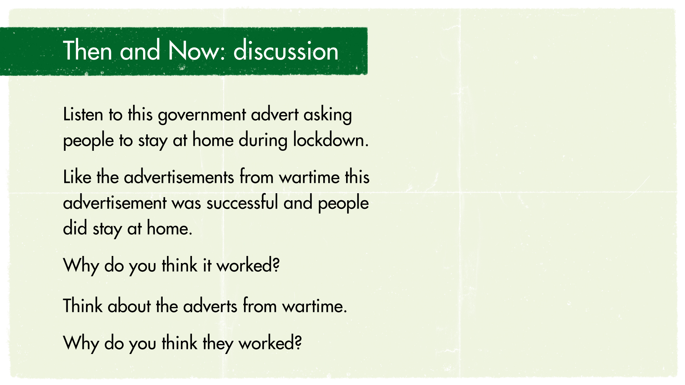

Notes:
Activity Sheet 1:
What features do you notice about the advertisements? How do they make you feel? Which one would you respond to if you were going to volunteer?
Things to consider:
Language - words and phrases used
Length of advert /amount of text – is it quick to listen to or read?
Images – what do they show? Who are they of?

Slide 12
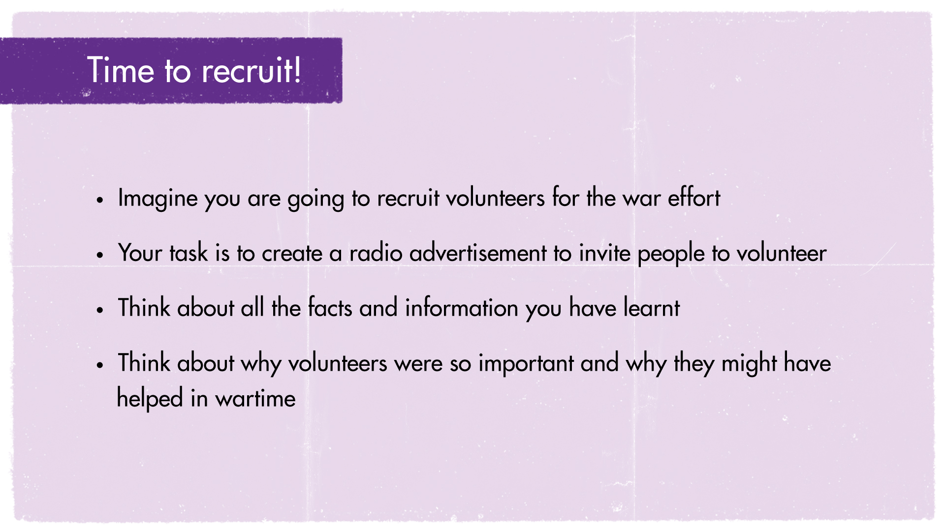
Notes:
The next few slides will explain the task in more detail.
Read the ‘Radio’ Factfile from Home Again.
Find the Radio Fact file (p6) herehttps://www.docdroid.net/yDVLPMc/a-sense-of-home-pdf

Slide 13
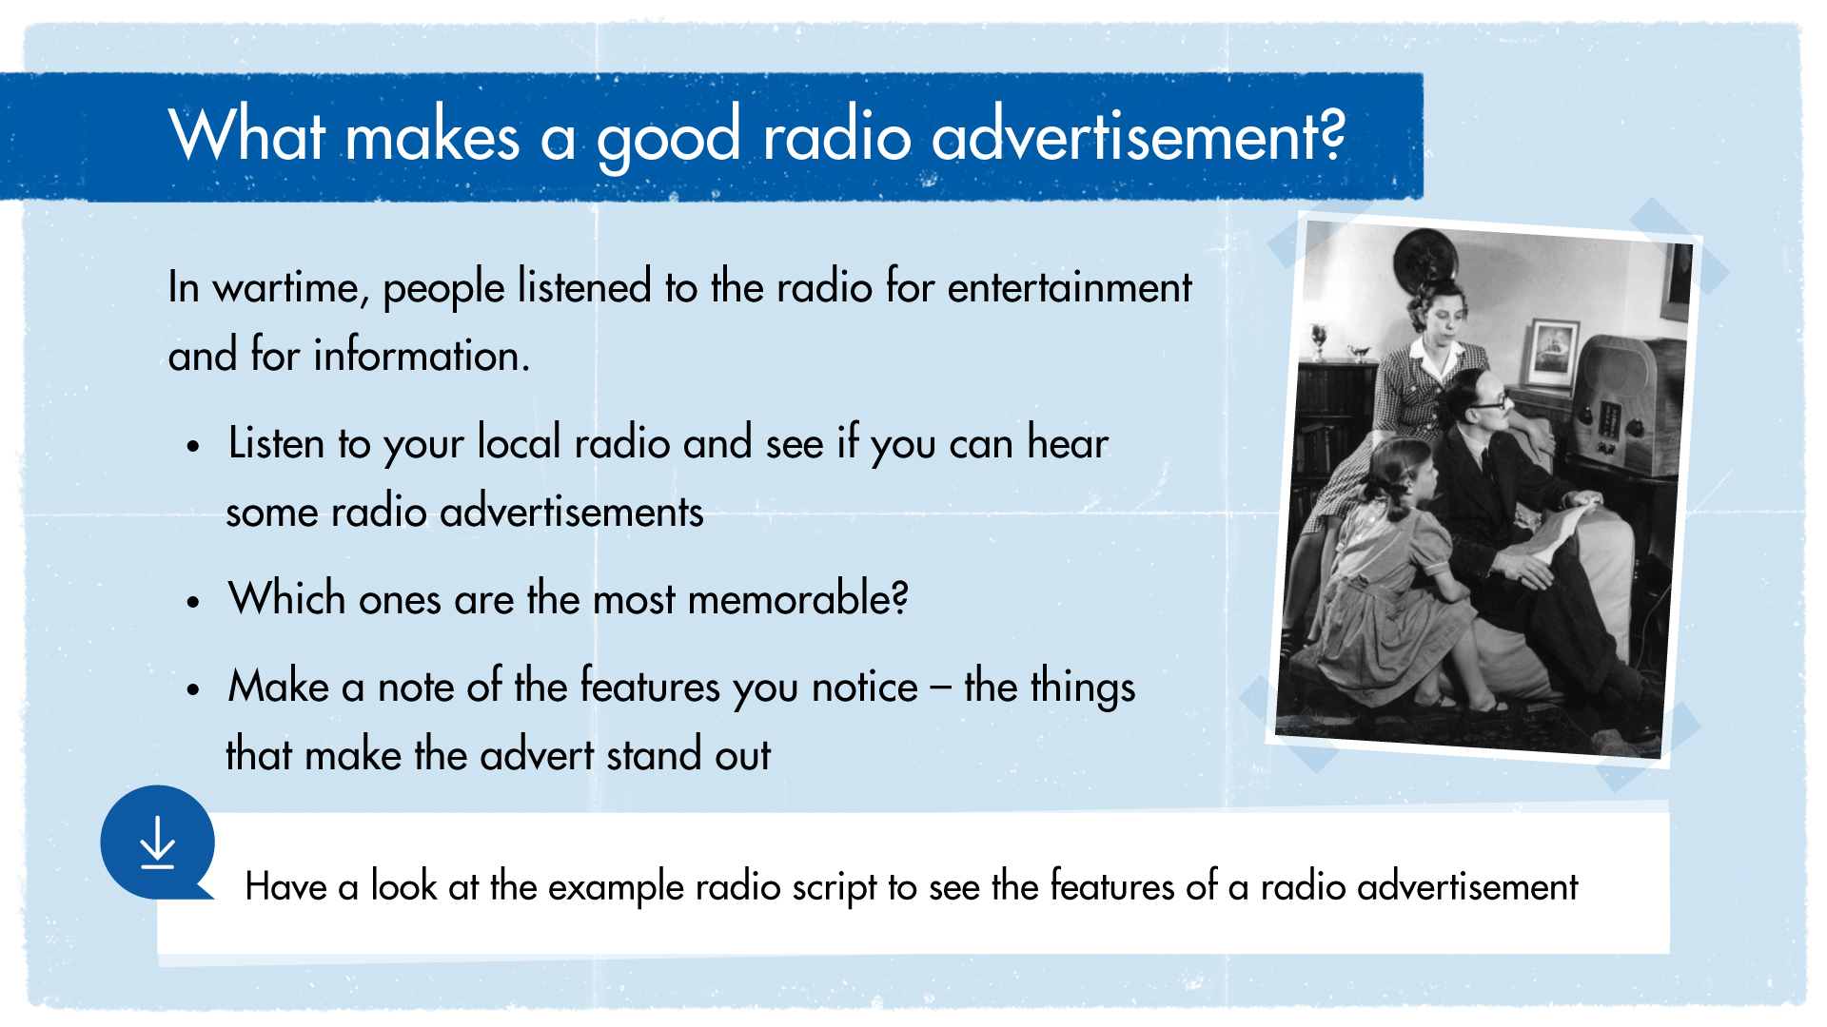
Notes:
Example script: https://storage.rblcdn.co.uk/sitefinity/docs/default-source/remembrancedocs/new-teaching-remembrance-resources/ks2_radioscript.pdf

Slide 14
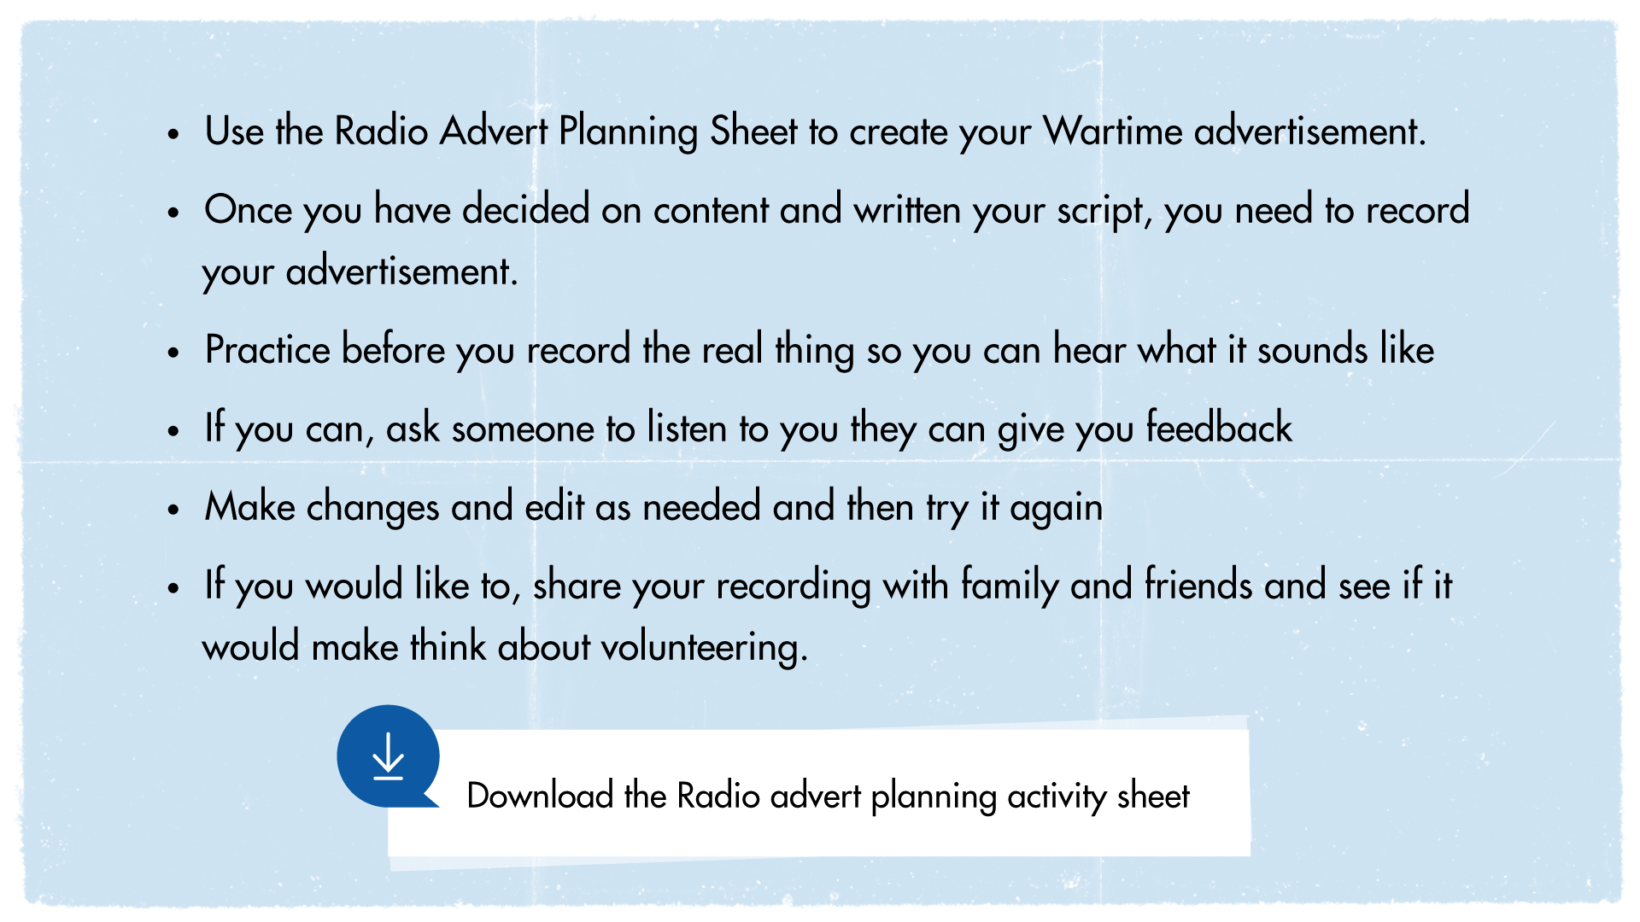
Notes:
Planning sheet: https://storage.rblcdn.co.uk/sitefinity/docs/default-source/remembrancedocs/new-teaching-remembrance-resources/ks2_radioadvertplanningsheet.pdf

Slide 15
